Slide 1
Software Quality Engineering
Lecture 1-
Other QA Activities
alina.arshad@nu.edu.pk

Slide 2
Informal desk checks, reviews, and walkthroughs
Desk check typically refers to informal check or inspection of technical documents produced by oneself, which is not too different from proofreading one’s own writings to catch and correct obvious mistakes.
Instead, desk checks should focus on logical and conceptual problems, to make effective use of the valuable time of software professionals.

Slide 3
Formal Technical Reviews (FTR)
FTR is one of the techniques for improving software quality.
The FTR is a software quality assurance activity with the objectives to uncover errors in function, logic or implementation for any representation of the software.
FTR (Formal Technical Review) is also a learning ground for junior developers to know more about different approaches to software analysis, design and implementation.

Slide 4
Formal Technical Reviews (Cont..)
FTR activities include walkthroughs and inspections.
Formal technical review methods began in 1976 with the publication of Fagan's code inspection techniques.
Reviews are the most widely used approach for assessing software quality.

Slide 5
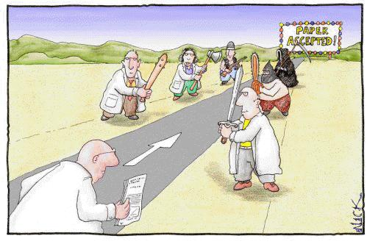
Peer Review
In software development, peer review is a type of software review in which a work product (normally some form of document) is examined by its author and one or more colleagues, in order to evaluate its technical content and quality.
Peer reviews identify problems and fix them early in the lifecycle.

Slide 6
Audit
Finding the problem is more important than the solution
ALBERT EINSTEIN

Slide 7
Software Audits
A software audit is an independent evaluation of software products or processes to ascertain compliance to standards, specifications, and procedures based on objective criteria that includes documents that specify:
The form or content of the product to be produced
The process by which the products shall be produced
How compliance to standards or guidelines shall be measured”

Slide 8
Audit Types (Cont..)
First Party Audit
Also known as internal audit.
Performed within your own company.
No external customers/companies are involved.
E.g. Audit of IT or accounts department.

Slide 9
Audit Types
There is a general framework for partitioning audits into various types. But the generic process for all audit types (both software and non-software) is basically the same.
Broadly, following are the audit types:
First Party Audit
Second Party Audit
Third Party Audit
System Audit
Process Audit

Slide 10
Audit Types (Cont..)
Second Party Audit
Also referred to as external audit.
Performed by a customer (first party) on their supplier (second party).
A contract is in place for the delivery of a product.
A supplier survey is a form of audit performed before a contract is signed off.
Another form of this audit exists when you are being audited by your customer.

Slide 11
Audit Types (Cont..)
Third Party Audit
Conducted by a third party, independent of customer or supplier.
A common type of third party audit is an ISO registration audit.
Regulated industries such as nuclear power stations & medical device manufacturers, often undergone third party audits by regulators.

Slide 12
Audit Types (Cont..)
System Audit
Known by several other names, like management audit, operational audit, program audit etc.
Covers large boundaries and wide scope.
Often cross organizational, process and product boundaries.
Cycle Time, Quality Systems, Functional Departments etc are the examples.

Slide 13
Audit Types (Cont..)
Process Audit
It examines an activity to verify that the inputs, actions & outputs are in accordance with defined requirements.
A process audit considers only a portion of the program used to develop the entire product (both hardware and software).
Software inspection is an example of Process Audit.

Slide 14
Software Audit Process
To perform an effective and efficient audit, the purpose and scope of the audit must be clearly defined.
The software audit process may be divided into four phases:
Preparation Phase
Performance (Execution) Phase
Reporting Phase
Corrective Action / Follow-up Phase

Slide 15

Defect
A defect or a bug is an error in coding or logic that causes a program to malfunction or to produce incorrect or unexpected results.

Slide 16
Defect Life Cycle
In software development process, the bug has a lifecycle. The bug should go through the life cycle to be closed.
A specific life cycle ensures that the process is standardized.
The bug attains different states in its lifecycle.

Slide 18
Severity of Defect
Indicate the impact each defect has on testing efforts or users and administrators of the application under test. This information is used by developers and management as the basis for assigning priority of work on defects.
A sample guideline for assignment of priority levels during the product test phase includes:
Critical
High
Average
Low

Slide 19
Guidelines for defect reporting
Be specific. State the expected behavior which did not occur - such as pop-up does not appear and the behavior which occurred instead.
Use present tense.
Don’t use unnecessary words.
Don’t add exclamation points! End sentences with a period.
DON’T USE ALL CAPS. Format words in upper and lower case (mixed case).
Mention steps to reproduce the bug compulsorily.

Slide 20
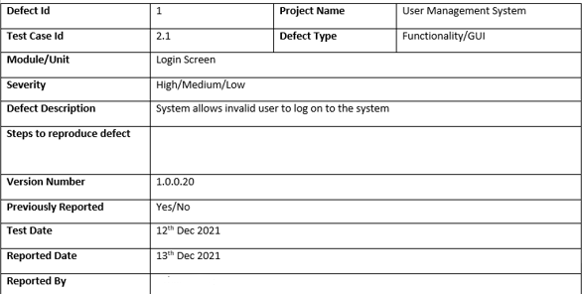
Defect Report Template - Sample

Slide 21
ROOT CAUSE ANALYSIS FOR DEFECT PREVENTION
Identify defects and their causes to apply targeted prevention.
Conducted early in development with limited product defect data.
Types of Root Cause Analysis
Logical Analysis
Establishes cause-effect links between faults and errors.
Requires expert knowledge of product, process, domain, and environment.
Statistical Analysis
Uses empirical data to predict cause-effect relations.
Draws evidence from local or similar projects.

Slide 22
ROOT CAUSE ANALYSIS FOR DEFECT PREVENTION
Focus Areas for Defect Prevention:
Human Errors: Address misconceptions with education and training.
Imprecise Designs/Implementations: Apply formal methods for alignment with specifications.
Tools and Standards: Use proven tools/standards suitable for the project environment.
Process Non-Conformance: Emphasize process adherence, clear definitions, and effective QA.
Predictive relations guide activities for:
Error blocking: (prevent faults from occurring).
Error source removal: (eliminate root causes).
Significance: Enables targeted and effective defect prevention strategies.

Slide 23
Formal Verification
The basic idea of formal verification is to verify the correctness, or absence of faults, of some given program code or design against its formal specifications.
The existence of formal specifications is a prerequisite for formal verifications.
Both formal specification techniques and formal verification techniques are referred to as formal methods collectively in literature.
When formal methods are used for software development, formal specifications are used upstream for requirement analysis and product specifications, and formal verifications or analyses are used downstream to verify the design and code before additional verification and validation (V&V) activities are carried out.

Slide 24
Use of formal methods
Constructing formal specifications: The expected behavior and other properties of the software artifacts are represented in formal models.
Performing formal verifications: Formal analysis techniques are applied on the product components, typically product code or formal designs, to verify their correctness with respect to their formal specifications, or to check for certain properties.

Slide 25
Formal specifications
Formal specification is concerned with producing an unambiguous set of product specifications so that customer requirements, as well as environmental constraints and design intentions, are correctly reflected, thus reducing the chances of accidental fault injections.
Formal specifications are similar in idea to various other defect prevention strategies based on development methodologies.
Formal specifications typically focus on the functional aspect or the correctness of expected program behavior, instead of non-functional aspects such as development schedule, personnel, cost, process, etc.
With formal specifications, the desirable properties for software specifications, the so-called 3Cs (completeness, clarity, consistency), can be more easily and sometimes formally analyzed and assured through various formal analysis and verification techniques.

Slide 26
Formal specification Categories
Descriptive specifications focus on the properties or conditions associated with software products and their components.
For example:
Entity-relationship diagrams , Logical (or logic) specifications , Algebraic specifications
Operational specifications focus on the dynamic behavior of the software systems. For example:
Data flow diagrams ,UML diagrams, Finite-state machines (FSMs),

Slide 27
Formal Verification and analysis
Formal Verification: Checks the conformance of software design or code to its formal specifications, ensuring that the software is fault-free with respect to these specifications.
Formal Frameworks:
Necessary to support arguments or inferences based on logical reasoning, algebraic relations, etc.
Influential and widely used frameworks include:
Axiomatic Correctness: Associates logical specifications with program or design elements using axioms to prescribe logical transformations before and after execution.
Weakest Pre-conditions: Focuses on the computational result captured by the final execution state and uses backward chaining operations to verify correctness.
Functional Correctness (or Program Calculus): Uses symbolic executions and axioms to verify that the program computes the mathematical function specified.

Slide 28
Fault Tolerance:
Fault tolerance refers to techniques that tolerate faults and local failures so that no global failures occur.
It involves keeping the system operational under dynamic problems by breaking the causal relations between faults and the resulting failures, thus "tolerating" these faults.
Within fault tolerance techniques, duplication generally implies that multiple programs are running in parallel, while backup involves a primary program or execution with backup used when problems or irregularities arise.

Slide 29
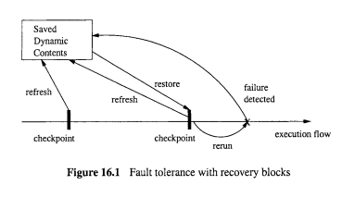

Slide 30
Fault tolerance with recovery blocks
The use of recovery blocks introduces duplication of software executions so that occasional failures only cause loss of partial computational results but not complete execution failures.
Periodic checkpointing and refreshing save the dynamic contents of software executions. If a failure is detected or suspected, the system performs two steps:
1. Rollback by restoring the saved dynamic contents associated with the latest checkpoint.
2. Rerun the lost computation.
In using recovery blocks, failures are detected but the underlying faults are not removed. The technique enhances system robustness under disturbances or unexpected usage environments.

Slide 31
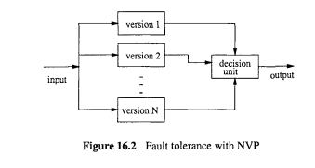
Fault tolerance with NVP

Slide 32
Fault tolerance with NVP
N-version programming (NVP) is another way to tolerate software faults by directly introducing duplications into the software itself (Aviiienis, 1995). NVP is generally more suitable than recovery blocks when timely decisions or performance are critical, such as in many real-time control systems, or when software faults, instead of environmental disturbances
Basic technique and implementation
The basic functional units of the software system consist of N parallel independent versions of programs with identical functionality: version 1, version 2, . . ., version N.
The system input is distributed to all the N versions.
The individual output for each version is fed to a decision unit.
The decision unit determines the system output using a specific decision algorithm. The most commonly used algorithm is a simple majority vote, but other algorithms are also possible.

Slide 33
Failure containment
Failure containment techniques reduce the impact or damage associated with certain system failures so that some accidents can be avoided or the related damage can be minimized.
Accidents are a subset of failures with severe consequences, and the pre-conditions to such accidents are called hazards.
Most of the failure containment activities are associated with safety-critical systems, where the main concerns are for the system to be as safe or to be as accident free as possible.
Hazard analysis and resolution play an important role in identifying hazards and dealing with them to contain failures related to potential accidents, thus ensuring system safety.

Slide 34
EFFECTIVENESS COMPARISON : Defect perspective
Among the different defect related perspectives and concepts, the QA alternatives can be compared by examining whether they are dealing with error sources, errors, faults, failures, or accidents.
This examination can be broken down further into two parts:
Detection or observation of specific problems from specific defect perspectives during the performance of specific QA activities.
Types of follow-up actions that deal with the observed or detected problems in specific ways as examined from the defect perspectives.

Slide 35
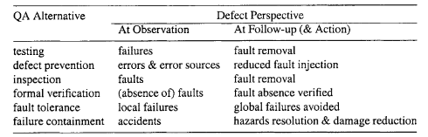
EFFECTIVENESS COMPARISON: Defect perspective
Notes:
Sometimes, they may be dealing with the same defect perspective, such as faults that are directly detected and removed in inspection. In other cases, they may be dealing with different defect perspectives, linked through some analysis activities in between. For example, testing detects failures during execution, and additional analyses are performed based on information recorded during the failed executions to locate and remove the underlying faults that caused the failures. Table 17.4 summarizes the perspectives or types of defects observed and dealt with by individual QA alternatives. To make the follow-up defect perspective more meaningful, we also include the general follow-up actions and results for each QA alternative.

Slide 36
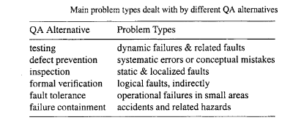
EFFECTIVENESS COMPARISON: Problem types
Different QA alternative might be effective for different types of problems, including dealing with different perspectives of defects, ranging from different errors and error sources, various types of faults, and failures of different severity and other characteristics.
Notes:
Table 17.5 summarizes the different problem types each QA alternative is effective in dealing with.

Slide 37
EFFECTIVENESS COMPARISON: Problem types
Defect prevention works to block some errors or to remove error sources to prevent the injection of related faults. Therefore, it is generally good at dealing with conceptual mistakes made by software designers and programmers.
Once such conceptual mistakes can be identified as error sources, they can be effectively eliminated.
One key difference between inspection and testing is the way faults are identified: inspection identifies them directly by examining the software artifact, while failures are observed during testing and related faults are identified later by utilizing the recorded execution information.
This key difference leads to the different types of faults commonly detected using these two techniques.
Inspection is usually good at detecting static and localized faults which are often related to some common conceptual mistakes, while testing is good at detecting dynamic faults involving multiple components in interactions.
Notes:
Some systematic problems can also be addressed by defect prevention techniques by using certain tools, processes,
standards, technologies, etc., to block the errors that are related to fault injections. These
problem types are also related to the pervasive, systematic problems we discuss below in
connection to defect levels.

Slide 38
The reasons of differences between the two types of QA alternatives:
Inspection involves static examination while testing involves dynamic executions. Therefore, static problems are more likely to be found during inspection, while dynamic problems are more likely to be found during testing.
It is hard for human inspectors to keep track of multiple components and complicated interactions over time, while the same task may not be such a difficult one for computers. Therefore, testing is generally better at detecting interaction problems involving multiple components.

Slide 39
EFFECTIVENESS COMPARISON
Formal verification deals with logical (or mathematical) correctness, and can be interpreted as extremely formalized inspection. Therefore, it shares some of the characteristics of inspection in dealing with static and logical problems.
Problem identification is only a side-effect of failing to produce a correctness proof.
Fault tolerance and failure containment are designed to work with dynamic operational problems that may lead to global failures or accidents.

Slide 40
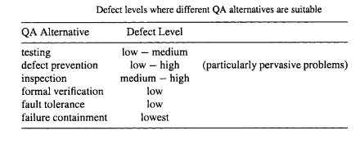
EFFECTIVENESS COMPARISON: Defect level and pervasiveness
Different QA techniques may be suitable for different defect levels or pervasiveness.
Notes:
ble 17.6 summarizes the defect levels each individual QA alternative is suitable for,

Slide 41
EFFECTIVENESS COMPARISON: Result interpretation and constructive information
Ease of result interpretation plays an important role in the application of specific QA techniques. A good understanding of the results is a precondition to follow-up actions.
For example, both inspection and testing are aimed at defect removal. However, inspection results are much easier to interpret and can be used directly for defect removal. Testing results need to be analyzed by experienced software professionals to locate the faults that caused the failures observed during testing, and only then can these faults be removed.

Slide 42
EFFECTIVENESS COMPARISON: Result interpretation and constructive information
Result interpretation for formal verification, fault tolerance, and failure containment is harder than that for inspection and testing. A significant amount of effort is needed to analyze these results to support follow-up actions.
For example, in a fault tolerant system using recovery blocks, repeated failures need to be dealt with off-line by analyzing the dynamic records. Much information related to unanticipated environment and usage not covered in the pre-planned testing activities may be included in these records.
Similarly, failure containment results typically need additional analysis support.

Slide 43
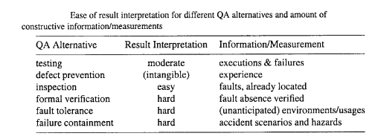
EFFECTIVENESS COMPARISON: Result interpretation and constructive information

Slide 44
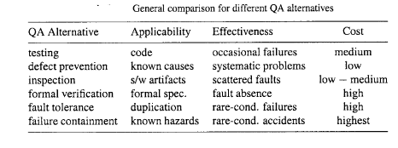
COMPARISON SUMMARY

Slide 45
Any question????

